Slide 1
International Student Tax Workshop
GWU Tax Department and International Services Office (ISO)
March 4, 2024

Slide 2
2023 International Student Tax Workshop
Agenda
Introductory concepts
Federal tax return basics
State tax return basics
Tax filing deadlines
Other Frequently Asked Questions
Sprintax
Q & A

Slide 3
Disclaimer

Slide 4
2023 International Student Tax Workshop
Disclaimer
GW (including the Tax Department and ISO) cannot complete or review your tax filings. This workshop is designed to give you the basic requirements
Students are solely responsible for the proper completion of their tax filings and should not rely completely on this workshop to complete their tax returns
Students should refer to the official IRS and state filing instructions and consider using the services of a professional tax preparer, if necessary

Slide 5
Introductory Concepts

Slide 6
2023 International Student Tax Workshop
Introductory Concepts
Nonresident alien (“NRA”) vs. resident alien (“RA”)
F-1 and J-1 visa status students are considered NRAs for the first 5 years in the US assuming no prior history
J-1 non-students are NRAs for the first 2 years in the US assuming no prior history
Prior history (including on other visas types) impacts determination, ask for guidance, if needed
Certain visas (A and G) are always NRAs

Slide 7
2023 International Student Tax Workshop
Introductory Concepts
Immigration Status | Date of U.S. Arrival | 2023 Tax Status | Earned Income | Forms to file
F or J student | After December 31, 2018 | NRA | Yes | 1040NR, 8843 and applicable state form
F or J student | After December 31, 2018 | NRA | No | 8843 only
F or J student | Before January 1,2019 | RA | Yes | Please follow the instructions of how U.S citizens complete tax forms. There is a tax software information on the next page
J - Non students (Scholars etc) | After December 31, 2021 | NRA | Yes | 1040NR, 8843 and applicable state form
J - Non students (Scholars etc) | After December 31, 2021 | NRA | No | 8843 only
J - Non students (Scholars etc) | Before January 1,2021 | RA |  | Please follow the instructions of how U.S citizens complete tax forms. There is a tax software information for you on the next page

Slide 8
2023 International Student Tax Workshop
Introductory Concepts
Resident Aliens
Resident aliens will file tax returns just like US citizens and permanent residents. IRS Free File lets you prepare and file your federal income tax online using guided tax preparation. You also have the option to use web-based services, like TurboTax, H&R Block Tax Software, or TaxSlayer, among others.
GW tax department does not endorse any particular tax filing program. You should research your options to find out which one will best suit your needs.
This workshop is not intended for resident alien students

Slide 9
Who must file for 2023?
Every nonresident alien who is an exempt individual for purposes of the substantial presence test must complete Form 8843, irrespective of income or days of presence.
Any nonresident alien who received taxable earnings or income from a US source during 2023 should generally file a federal income tax return (1040-NR) and applicable state tax return
Form 1040NR-EZ has been discontinued since 2020 tax season.

Slide 10
2023 International Student Tax Workshop
Introductory Concepts
No income
Nonresident aliens with no income in 2023 have a simplified filing requirement
Form 8843 is the only required form
See an example 8843 on the Tax Department website
NRAs with No US presence in 2023
Nonresident aliens who had no US source income and no US presence during 2023 will not have any US tax filing requirement for 2023.

Slide 11
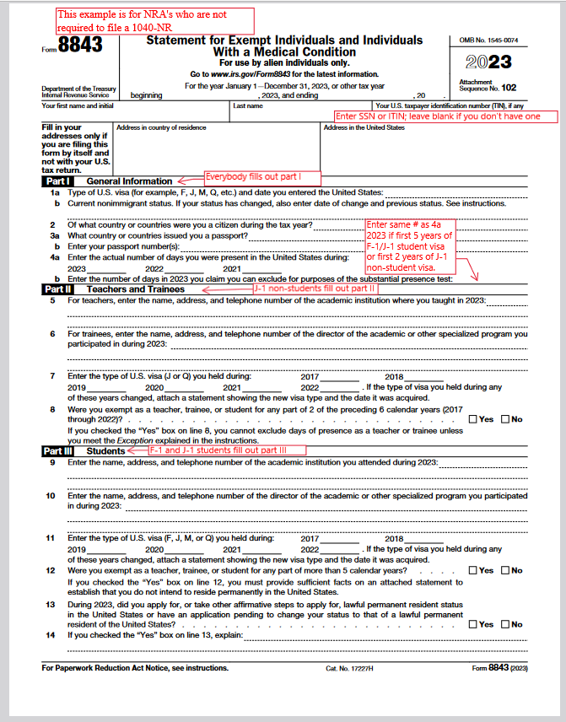
2023 International Student Tax Workshop
Introductory Concepts

Slide 12
2023 International Student Tax Workshop
Introductory Concepts
Social Security/Medicare Tax (FICA Taxes)
Nonresident alien F-1 or J-1 visa holders are exempt from FICA. If you had FICA tax withheld from your GW paycheck as shown on Form W-2, send an email to tax@gwu.edu and we will research.
Nonresident alien F-1 or J-1 students on OPT/CPE/Practical Training are exempt from FICA at other employers. We can’t assist with recovery, but the Refunding FICA Taxes document on our website may help. Talk directly to the outside employer

Slide 13
2023 International Student Tax Workshop
Introductory Concepts
Tax withholding and return filing requirements
The tax year for individuals is calendar year, January 1 - December 31. In most cases employers withhold tax from your paychecks during the tax year.
A tax return is a reconciliation between tax that has been withheld and tax that is owed. Depending on your specific circumstances, you will either get a refund for tax overpayment or owe the government money for tax underpayment.

Slide 14
2023 International Student Tax Workshop
Introductory Concepts
Nontaxable income for nonresident aliens
Scholarships for tuition and fees required for enrollment or attendance, or for fees, books, supplies, and equipment required for courses
Scholarships received from outside the US
Money transferred from parents/relatives overseas
Income “earned “ in their home country (investment income, rent job before moving to USA etc.)
Interest on regular savings account

Slide 15
2023 International Student Tax Workshop
Introductory Concepts
Common types of taxable income
Compensation for services: Teaching or graduate assistantships, and other on or off campus employment. Wages are most commonly reported on Form W-2.
Scholarships, fellowships, or grants from a US source that goes towards living or travel expenses, i.e., stipends. Usually reported on Form 1042-S.
Dividends or capital gains from U.S. mutual funds, stocks or bonds
Other income: Prizes, awards, royalties from US sources

Slide 16
2023 International Student Tax Workshop
Introductory Concepts
Common tax reporting documents for nonresident aliens
W-2: received by January 31, 2024
Reporting wages, salary, compensation, i.e., employment earnings
1042-S: receive by March 15 2024
Treaty-exempt salary, wages, stipends, prizes, etc.
Taxable stipends, prizes, etc.
1099-NEC: received by January 31, 2024
Reporting nonemployee compensation from outside company if they treated you as an independent contractor during 2023
1098-T: NRAs can ignore this form
1095 B/C: for information only

Slide 17
SAMPLE W-2
SAMPLE

Slide 18
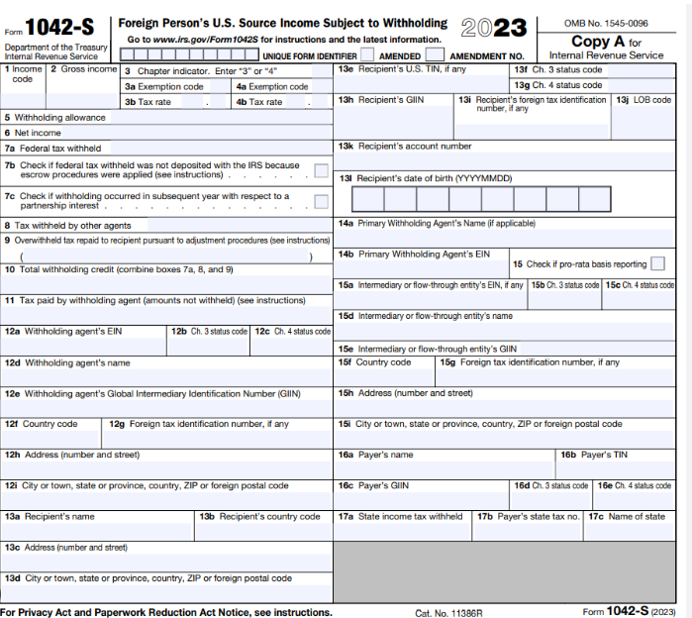
Sample 1042-S

Slide 19
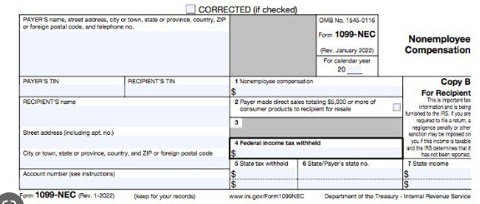
SAMPLE 1099-NEC

Slide 20
Federal Tax Return Basics

Slide 21
2023 International Student Tax Workshop
Federal Tax Return Basics
Federal tax return for nonresident aliens
Form 1040-NR and instructions, (see Sprintax Basics page)
Form 8843 and instructions (see Sprintax Basics page, though note if you do not have a 1040-NR you will need to prepare manually – see example 8843 for your reference)

Slide 22
2023 International Student Tax Workshop
Federal Tax Return Basics
Nonresident alien spouse and dependents
Same filing requirements as main visa holder
No Joint returns for Nonresident aliens
Nonresident alien can elect to file as resident if married to a resident taxpayer - but do the math on both options first

Slide 23
2023 International Student Tax Workshop
Federal Tax Return Basics
Where to get your tax reporting documents
W-2 from GW: retrieve from GWeb Info System or contact Payroll Services (phone: 571-553-4277 or email payroll@gwu.edu)
1042-S from GW: email the Tax Department at tax@gwu.edu (include GWid in your email)
1099-NEC: contact your employer
If missing W-2 or 1042-S from outside company, contact them, not GW

Slide 24
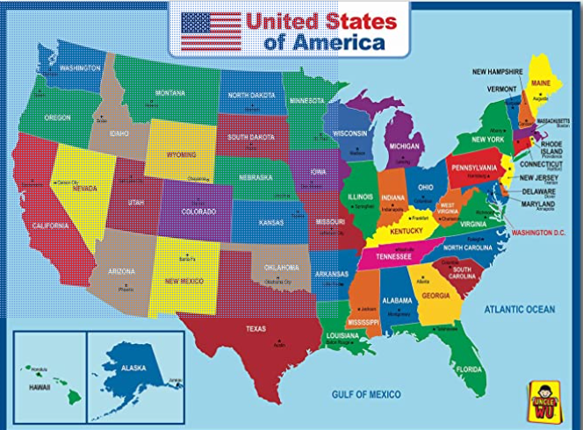
State Tax Return Basics

Slide 25
2023 International Student Tax Workshop
State Tax Return Basics
State tax returns
DC Form D-40 and instructions
MD Form 502 and instructions
VA Form 760 and instructions
Sprintax can prepare state tax returns for a fee, or you can prepare manually
The above tax returns assume full year residency. If you moved states, read the state form instructions for both states to determine residency and the proper form, as some states have part-year filing requirements. The Tax Department cannot advise on which specific state forms to file

Slide 26
2023 International Student Tax Workshop
State Tax Return Basics
State tax return basics
Complete your federal tax return first
DC, MD and VA all use federal adjusted gross income (FAGI) as the starting point. FAGI can be found on line 11 of 1040-NR .Transfer this number to your state return on the applicable line

Slide 27
2023 International Student Tax Workshop
State Tax Return Basics
State tax return basics (continued)
Exemption amounts for full year residents
DC = $0
MD = $3,200 (this exemption is reduced once FAGI exceeds $100,000)
VA = $930
These are standard amounts. If you are not filing your state return as a full year resident, then consult the state instructions for the applicable amount

Slide 28
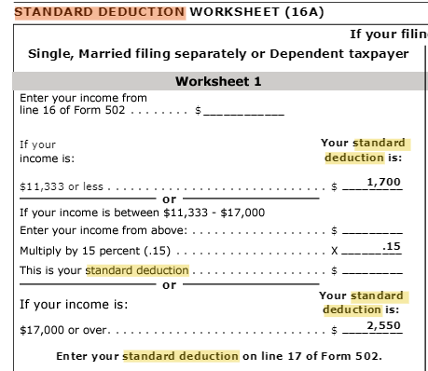
2023 International Student Tax Workshop
State Tax Return Basics
State tax return basics (continued)
Standard deduction amounts for full year residents (Indian nationality students only)
DC = $13,850
MD = See screen shot
VA = $8,500
Note that states require you to claim the same type of deductions on your state return as federal return (itemized vs. standard). Because only students with Indian nationality can claim the standard deduction on their federal return, only such students can use the standard deductions on their state returns

Slide 29
2023 International Student Tax Workshop
State Tax Return Basics
Other states
If you lived in a state other than DC, MD, or VA and earned income there, you may have a filing requirement in that state. See the applicable state tax authority’s website for guidance. GW cannot provide personal tax advice on the state filing requirements.

Slide 30
Tax Filing Deadlines

Slide 31
2023 International Student Tax Workshop
Tax Filing Deadlines
Due dates
Federal tax return: April 15
DC tax return: April 15
MD tax return: April 15
VA tax return: May 1
Refer to instructions for compilation and mailing
When filing by mail, you must send your tax filing by certified mail, return receipt requested, and keep a copy and proof that it was mailed and received.
Sprintax is now live for federal e-filing if eligible.

Slide 32
2023 International Student Tax Workshop
Other Frequently Asked Questions
Can tax filing deadlines be extended?
If you cannot file your annual US Federal and State income tax returns by the filing due date, make sure to at least file an extension of time by the original due date. See links below for more information. Note that the extension is not applicable for tax payment.
The extension will go through October 15. The links to the extension applications are below:
Federal Form 4868
DC Extension
VA: No application for filing extension is required
MD Extension

Slide 33
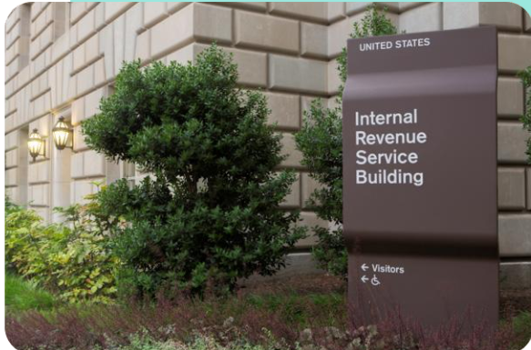
2023 International Student Tax Workshop
Other Frequently Asked Questions
When will I receive my refund?
Federal: Contact IRS to follow up. See ‘Where’s my refund’
State: Contact the state department of taxation

Slide 34
2023 International Student Tax Workshop
Other Frequently Asked Questions
Missed a year? Filed as a resident by mistake?
Don’t Panic – but do set the record straight
Never filed…..
Catch up
Can back-file at any stage
Can only claim a refund for previous 3 years
Misfiled …..
Form 1040-X, Amended U.S. Individual Tax Return, and/or applicable state amended tax return

Slide 35
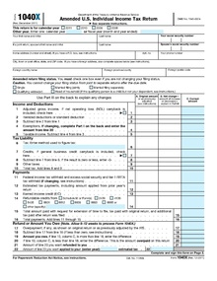
2023 International Student Tax Workshop
Other Frequently Asked Questions
How do I amend my federal tax return?
If you realize that you made an error on this year's or a prior year's tax return, or if you filed a resident tax return when it should have been a nonresident alien tax return, you can file an amended return.
Sprintax can do it for you for a fee. Alternatively, you can try to do it yourself by following IRS instructions for Form 1040-X, in which you compare the amounts as originally reported with the correct amounts.

Slide 36
2023 International Student Tax Workshop
Other Frequently Asked Questions
Implications of not filing
Nonresidents are required to comply with all US laws, including the tax law
Filing tax forms (even if only 8843) is part of maintaining visa status in US
Not filing could affect future immigration status (H1B, LPR)
Fines, penalties, interest can accrue if the IRS are owed
Might be missing out on a refund!

Slide 37
Sprintax

Slide 38
2023 International Student Tax Workshop
Sprintax
Sprintax Basics
Head to the Sprintax page on the tax department website
Email tax@gwu.edu for access code (must have current relationship with GW or had one in 2023); include GWid in email; enter access code in the “review your order” section
Access code prepares Forms 1040-NR and 8843 for free
Federal Form W-7 (application for ITIN) and state tax returns are available for fees paid directly to Sprintax
Support is handled by Sprintax directly, use their online chat system or email hello@sprintax.com

Slide 39
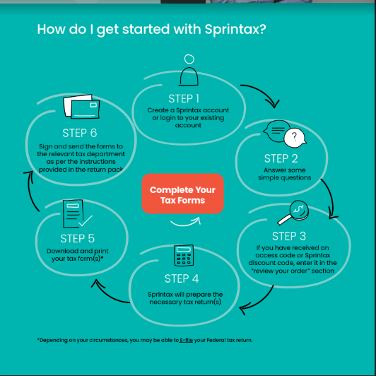
2023 International Student Tax Workshop
Sprintax

Slide 40
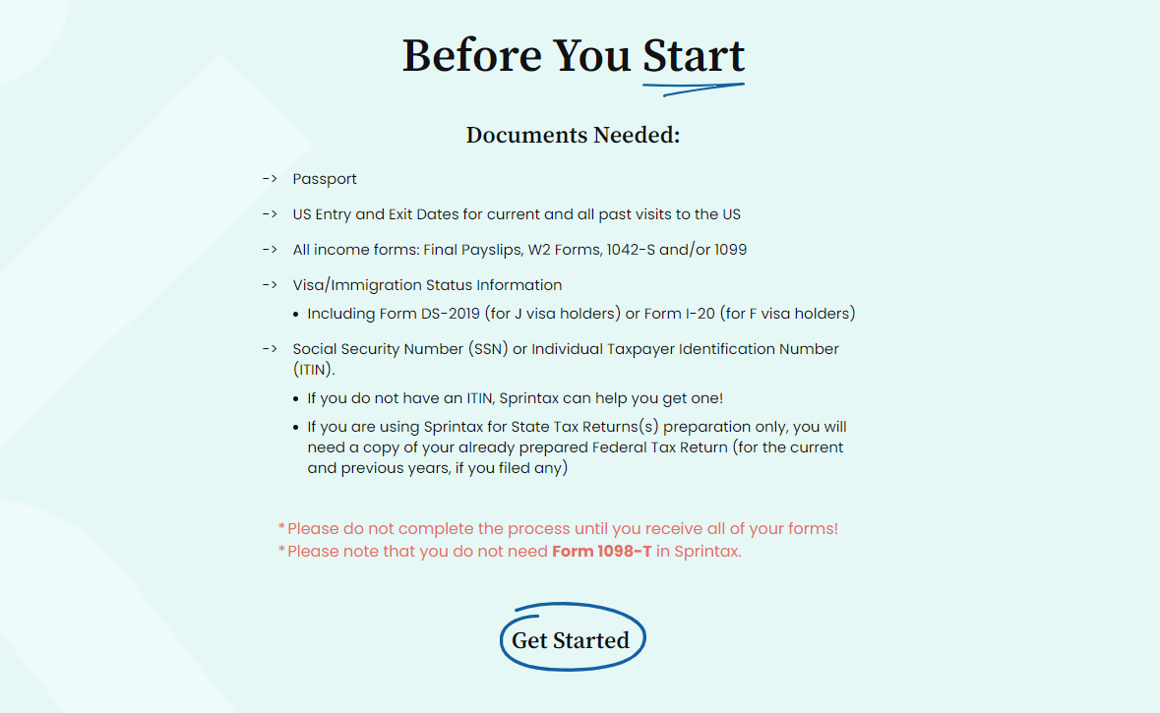
2023 International Student Tax Workshop
Sprintax

Slide 41
Q & A

Slide 42
2023 International Student Tax Workshop
For More Information
Questions - Contact the Tax Department at or tax@gwu.edu
Please give us your GWID and mention Tax filing question on the subject line of your email.

